Slide 1
EDA & machine-Learning
Szőllősi Szilárd-Árpád

Slide 2

OBJectives
The goal of this project is to find a relationship between the behavior of the customers and buying of the products .
Based on the data from previos customers , we have to create a model that predicts if a buyer will or will not buy something.

Slide 3

The data
Our database is made up of 21 different types of data , where we have :
Numerical data: Time spent on different pages , number of time , these were visited , etc.
Object data: Cookie settings , Marital status , Gender ,etc.
Boolean data: this is represented by the result of the page visti , the customer bought the product(yes) or not (no).

Slide 4
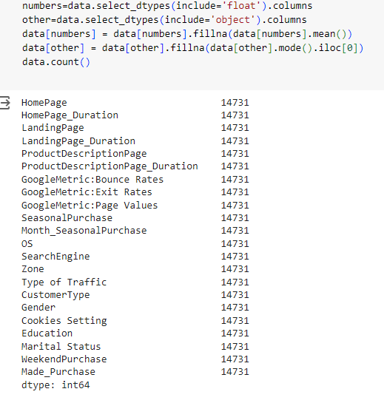
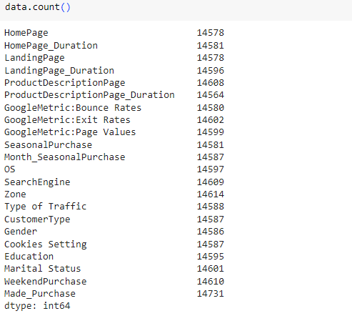
EDA
First we need to check if all the cells are not null , after I have seen that not all the cells have data , I have used the mean and the mode of the different data types in order to get rid of the empty cells.
We can see that the number of rows is now the same for all the colums , so we can continue our EDA analysis.

Slide 5
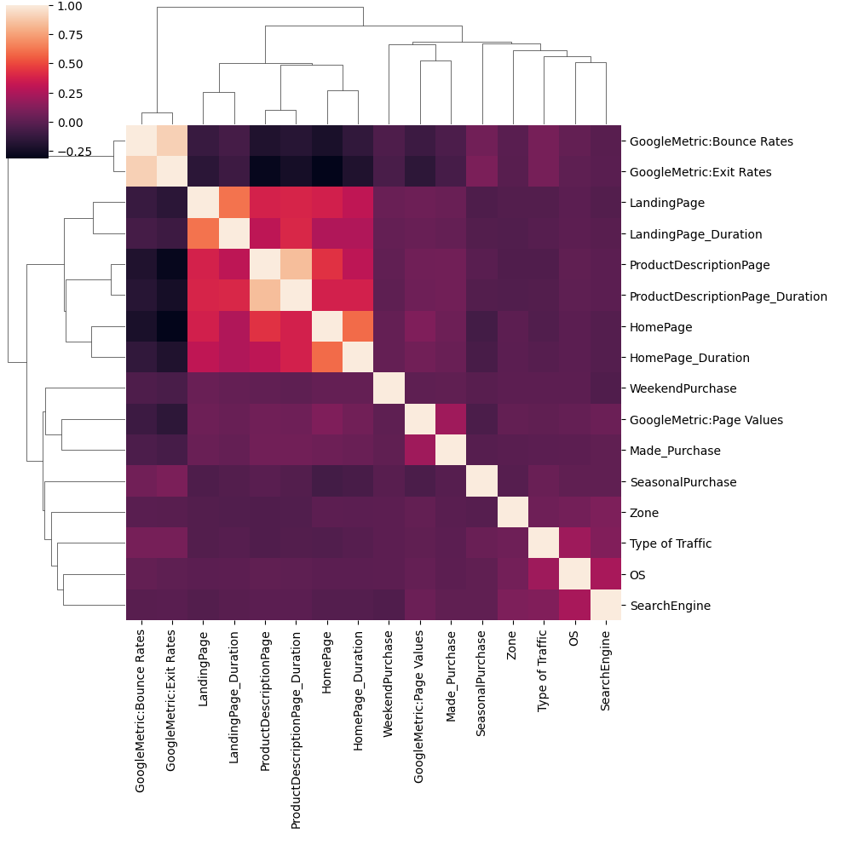
EDA
The next step was checking if there are any strongly correlated data types. Thus by displaying the correlation on a clustermap it was clear that certain fields were highly correlated , which led to the elimination of some of them.
After this I have checked for outliers in the remaining data , using the boxplot method , which showed clear evidence of outliers .
To resolve this issue I used the Interquartile Range Method.(IQR)

Slide 6
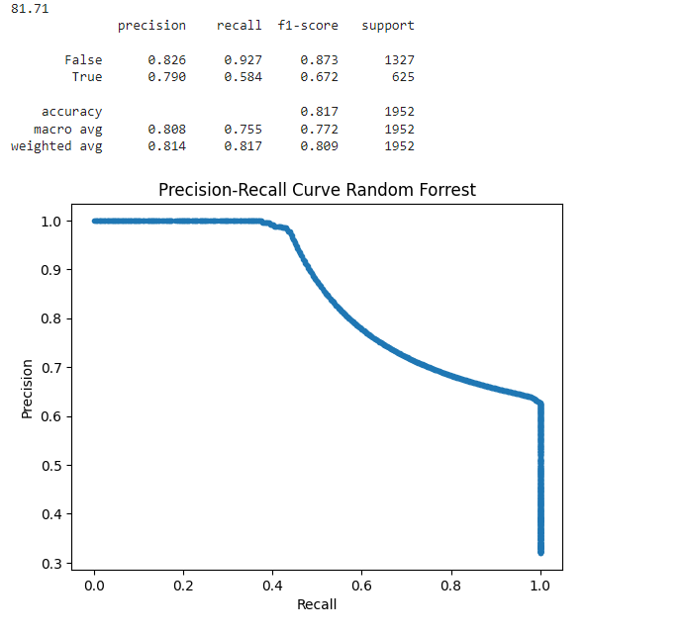
Machine-learning
After the data was cleaned I created different learning models using the sklearn library.
The first one was made using Random Forrest.
On the tests using the training data it scored 81.71 , however on the test data it scored a significantly lower score.

Slide 7
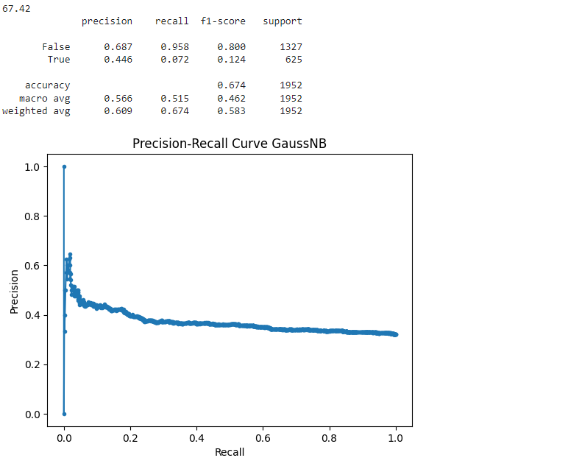
Machine-learning
The next model was made using the Gaussian Naive Bayes model:
It scored 67.42% on the training data wihich was quite close to it’s final result on the test data.

Slide 8
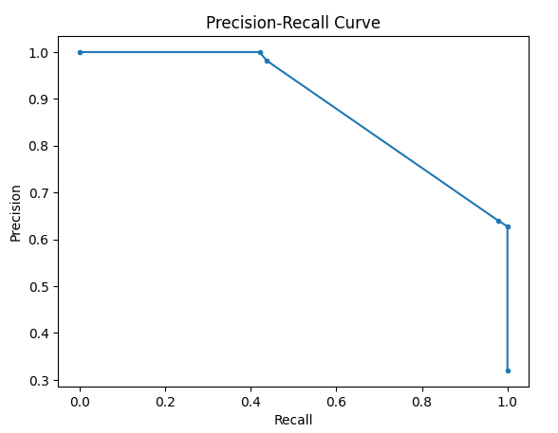
Machine-learning
The last model created was made using the Decission-tree:
It also scored quite high on the training data: 81.71% , however on the final test data it did not perform quite well.

Slide 9
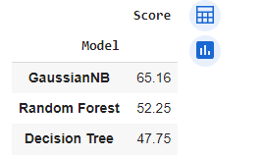
Machine-learning
Here we can see the final results of the three models on the test data. We can see , that the scores of the Random Forest method and Decision Tree deviate very much from the training score , while the result of the Gaussian model is very close to it’s training score.

Slide 10
Conclusion
We can see that despite having better scores on the training data , on the test data the Random Forest and Decision Tree were not performing well , why is that ?
This happens because of the phenomenon called “Overfitting” , this is because the model is trying to adjust it’s parameters as much as it can to the current data , however if the data is not perfect or it is slightly biased , we can easily get an overfitted model.
The ROC curve and test scores of the Gaussian model demonstrate it’s robustness in various test circumstances , thus being the most reliable model to use for prediction of future purchases in this instance.

Slide 11

Thank you
Szőllősi Szilárd-Árpád
https://github.com/SzSzilard03/Project34

